Slide 1
Chloroplast
Cytoplasm
Mitochondria
Nucleus
Cell Membrane
Lysosome
Golgi Apparatus
Endoplasmic Reticulum
Cell Wall
Vacuole
Ribosomes
Click on organelle to activate name (cursor will change for “live” organelles).
Hover over name. Wait for hand cursor to appear. Click for more details.

Slide 2
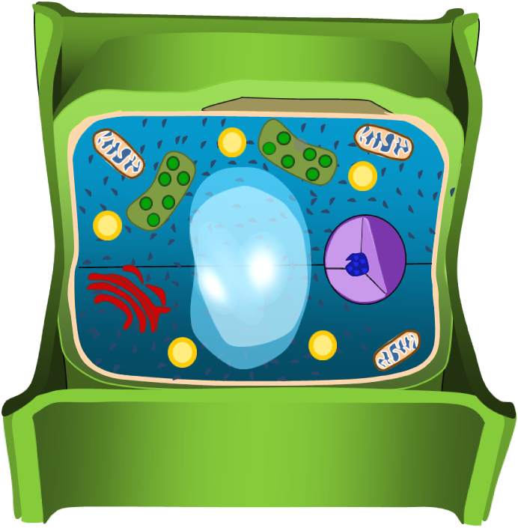
ENDOPLASMIC RETICULUM. A membrane network within the cytoplasm of cells involved in the synthesis, modification, and transport of cellular materials.
Click to return to main page

Slide 3
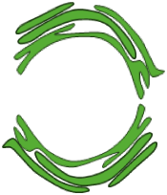
CO₂
O₂
H₂O
Glucose
CHLOROPLASTS. Produces by photosynthesis. It will take water and carbon dioxide, and change it in to oxygen it’s a very simple process.
Click to return to main page

Slide 4
Lysosome: is like garbage disposal. Using molecules of water, a lysosome breaks down large molecules into small molecules by inserting the water into the chemical bond of the large molecules.
Click to return to main page

Slide 5
NUCLEUS. Nucleus consist of four elements: nucleolus, nuclear envelope ,chromatin and nucleoplasm. Its job is to control any cell activity. so basically it’s the headquarters of the cell. The nucleolus copies DNA, and will also work with ribosomes.
Click to return to main page

Slide 6
Glucose
ATP
O2
H2O
MITOCHONDRIA. Takes Glucose and oxygen and will transform it into ATP , Carbon dioxide, and water.
Click to return to main page

Slide 7
VACUOLE. A vacuole in plants is larger than those in animal cells. It acts like a storage system in which it holds important substances it also helps support the plant. The pressure that’s caused by water filling the cell vacuole pushes out against the cell wall that gives it enough strength to hold up medium large green plants. If you ever notice that if you don’t give your plants enough water they wilt and droop. Well now you know why they do because the vacuole doesn’t have enough water filled inside it.
Water
Vacuole
Click to return to main page

Slide 8
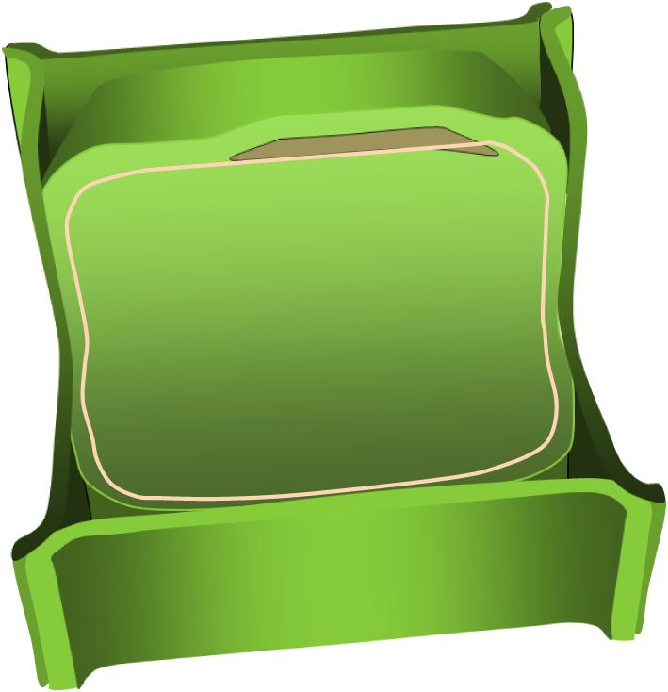
CYTOPLASM. Made of proteins, fats, and other molecules suspended in water, includes the nucleus. It is a complex, semi-fluid, translucent substance that holds together the living matter of plant.
Click to return to main page

Slide 9
RIBOSOMES. It controls protein, synthesis and where it will take place.
Click to return to main page

Slide 10
CELL WALL. Provides the cell protection from any injury. It will work together with the vacuole to provide skeletal support.
Click to return to main page

Slide 11
GOGLI COMPLEX. It will modify the chemicals and make them functional, it acts also like a storage system and may sometimes produce ER.
Click to return to main page

Slide 12
CELL MEMBRANE. Acts like a boundary layer to keep the cytoplasm in. Its interlocking surfaces will take the cells and bind them together!
Click to return to main page

